Slide 1


Mitron Bank
Resume Project Challenge 8
M
A new line of Credit Cards for Mitron Bank
Presented by Gouhar Ali
Created by Gouhar Ali

Slide 2
AGENDA
1
Problem Statement
2
Data sets
3
Dashboard
4
Recommendation
Created by Gouhar Ali

Slide 3
Problem Statement
1
M
Mitron Bank is a legacy financial institution headquartered in Hyderabad. They want to introduce a new line of credit cards, aiming to broaden its product offerings and reach in the financial market.
AtliQ Data Services came to know about this through an internal link and approached Mitron Bank with a proposal to implement this project. However, strategy director of Mitron Bank, Mr.Bashnir Rover is skeptical and asked them to do a pilot project.
They provided a sample dataset of 4000 customers across five cities on their online spend and other details.
Created by Gouhar Ali

Slide 4
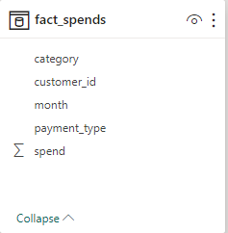
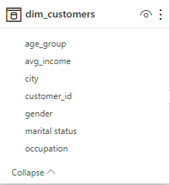
Data sets
2
We have provided 2 csv files dim_customers and fact_spends.
In dim_customers columns are (Age_group, Avg_income, City, Customer_id, gender, Marital status, and Occupation) .
In Fact_spends columns are (category, customers_id, month, payment_type,and spends) .
1
Created by Gouhar Ali

Slide 5
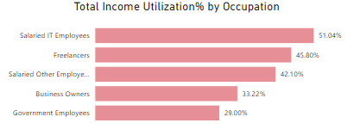
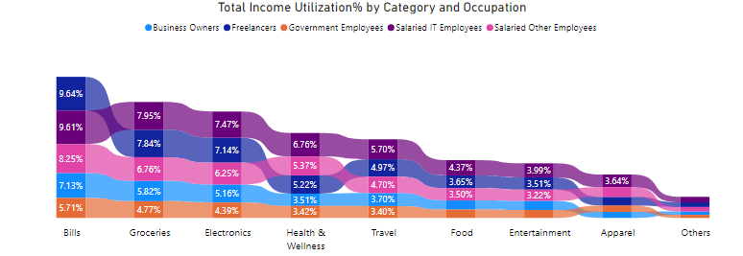
4
Recommendation
Occupation wise analysis
Salaried IT Employees have the highest Utilization % which is near about 51.04% of their monthly Income in 8 different category (Groceries, Electronics, Health & wellness, travels, Food, Entertainment, apparel, and others).
2.
Freelancers have the 2nd highest Utilization % which is near about 45.80 % of their monthly Income in 7 different category (Bills, Groceries, Electronics, travels, Food, Entertainment, and others).
According to the management of Mitron Bank they can offer Credit Cand to both ( Salaried IT Employees and Freelancers) because of there higher Income Utilization %.
Created by Gouhar Ali

Slide 6
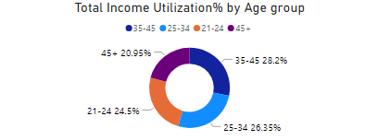
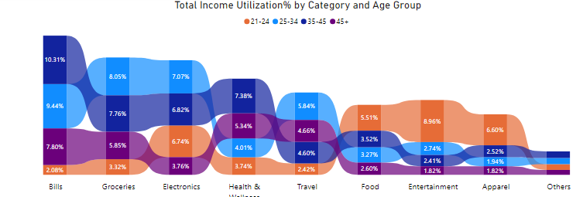
Age Group wise analysis
1.
Age Group(35-45) has the highest Utilization % which is near about 28.2 % of their monthly Income in 3 different category (Bills, Health & wellness , and others).
2.
Age Group(25-34) has the 2nd highest Utilization % which is near about 26.35 % of their monthly Income in 3 different category (Groceries, Electronics, and travel).
3.
Age Group(21-24) has the 3nd highest Utilization % which is near about 24.5 % of their monthly Income in 3 different category (Food, Entertainment, and Apparel).
According to the management of Mitron Bank they can offer Credit Cand to Age Group (35-45), (25-34), and (21-24) because of there higher Income Utilization %.
Created by Gouhar Ali

Slide 7
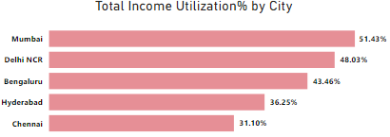
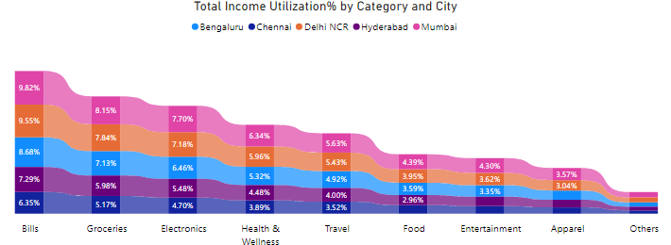
City wise analysis
1.
Mumbai has the highest Utilization % which is near about 51.43 % of their monthly Income in all different category.
According to the management of Mitron Bank they should offer Credit Cand to Mumbai because of there higher Income Utilization %, but they should offer Credit Card to Delhi NCR, Bengaluru, Hyderabad and Chennai also.
Created by Gouhar Ali

Slide 8
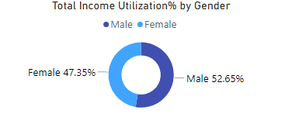
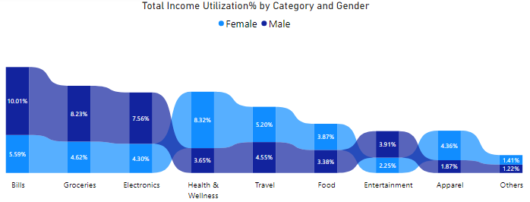
Gender wise analysis
1.
Male has the highest Utilization % which is Equal to 52.65 % of their monthly Income in category (Bills, groceries, Electronics, and Entertainment .
2.
Femail has the 2nd position in Utilization % which is Equal to 47.35 % of their monthly Income in category ( Health & wellness, travels, Food, Apparel, and others.
According to the management of Mitron Bank they should offer Credit Cand to both Male and Female.
Created by Gouhar Ali

Slide 9
Dhaval Patel Sir
Hemanand Sir
THANK YOU!
END
Created by Gouhar Ali

